Slide 1
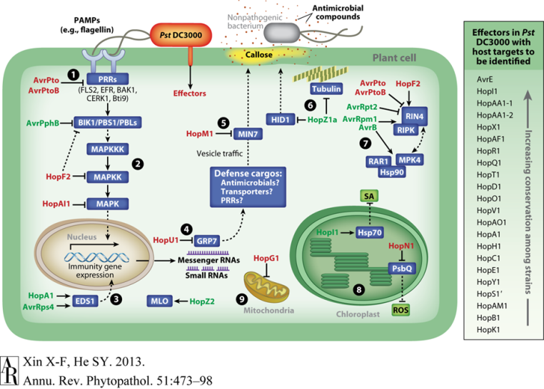

P. syringae effectors
(e.g., AvrPto)
Immune suppression
Wet apoplast
creation
maintenance
HopM1/AvrE
(P. syringae effectors)
high humidity
Figure 1: Pst DC3000 bacteria use a needle-like type III secretion system to inject “effector” proteins (names indicated in red or green) into the plant cell to attack plant proteins (blue boxes); many of which are components of the plant immune signaling pathway and/or are involved in regulating water content in the apoplast.

Slide 2
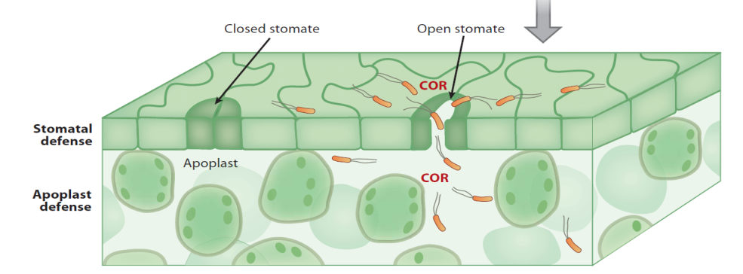

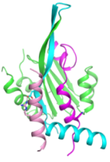

Jasmonate regulation of disease development
COR
COR
JA-Ile
TPL
NINJA
JAZ
MYC
JA response gene
J
A
Z
Figure 1: Stomatal guard cells in the leaf epidermis and mesophyll cells inside the leaf can respond to pathogens by closing stomata and establish a hostile mesophyll apoplast environment to prevent nonspecific bacterial invasion or multiplication. Virulent pathogen Pst DC3000 bacteria evolved the jasmonate-mimicking toxin coronatine (COR) to activate JA signaling cascade to suppress stomatal and apoplast defenses to facilitate entry and multiplication.

